Slide 1
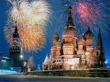
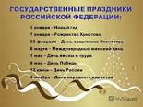
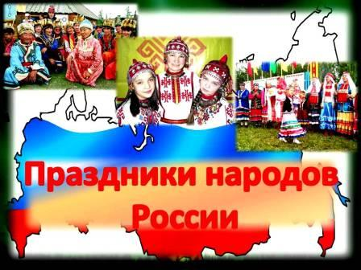
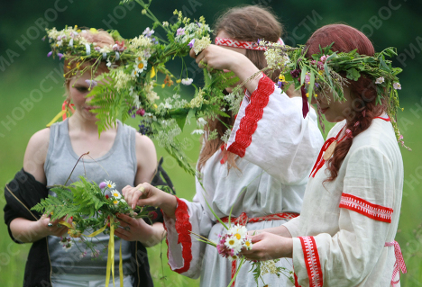
HOLIDAYS IN RUSSIA

Slide 2
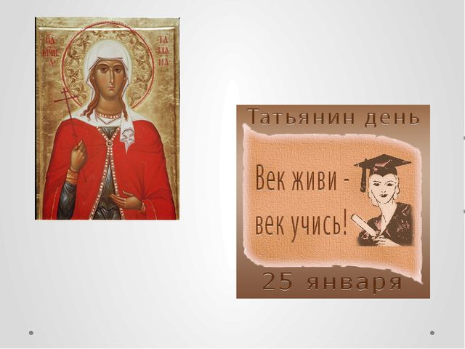

Slide 3
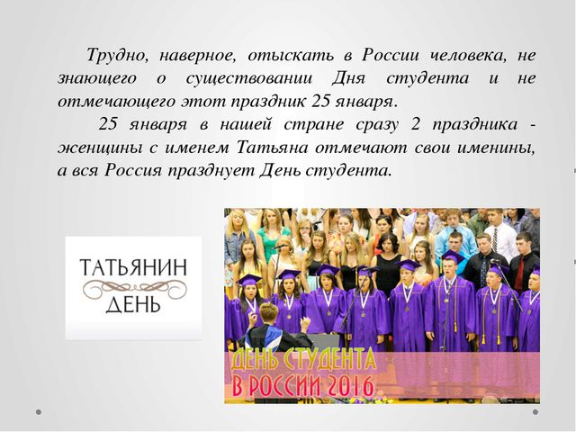

Slide 4
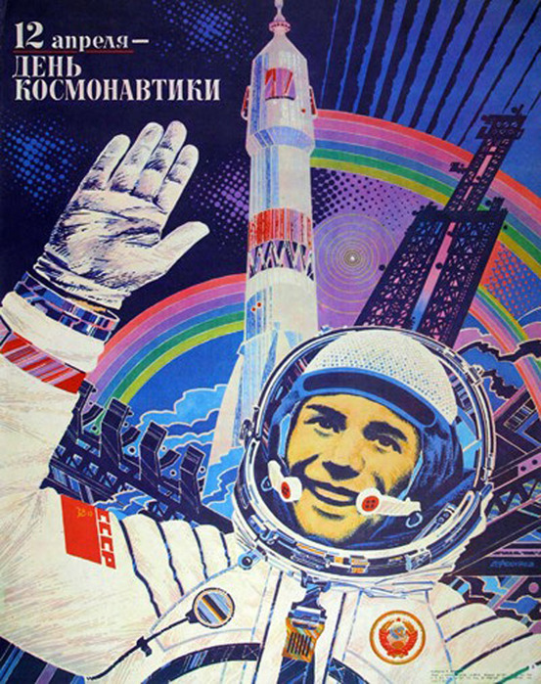

Slide 5
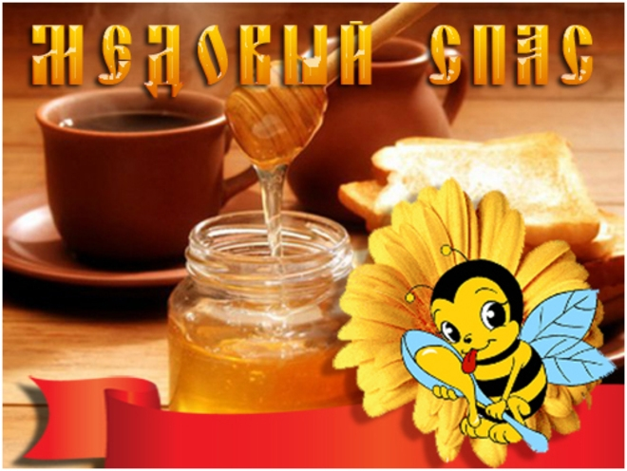

Slide 6
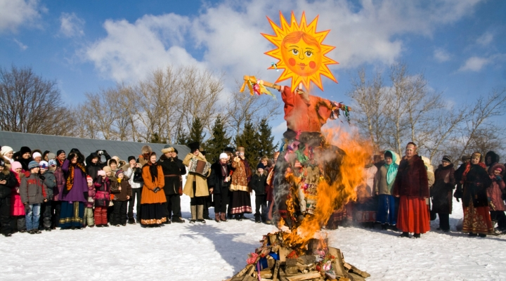

Slide 7
Some other celebrations in Russia
Cosmonautics day
Maslenitsa
Medoviy spas
Yablocniy spas / Apple day
Homework:What other special days are popular in our county? Find information on another celebration in Russia and research the history behind it. Write and tell us about it. You can make a presentation. (Sp on Russia p.3)

